Slide 1
Name Entity Recognition
Bharat Sakarwal

Slide 2
Context
NER data set which contains sentences and mapping of every word to respective NER tag
Preprocessing and EDA for NER data.
Predictive Model to anticipate entity tagging for a new sentence.
Model Deployment and Monitoring.

Slide 3
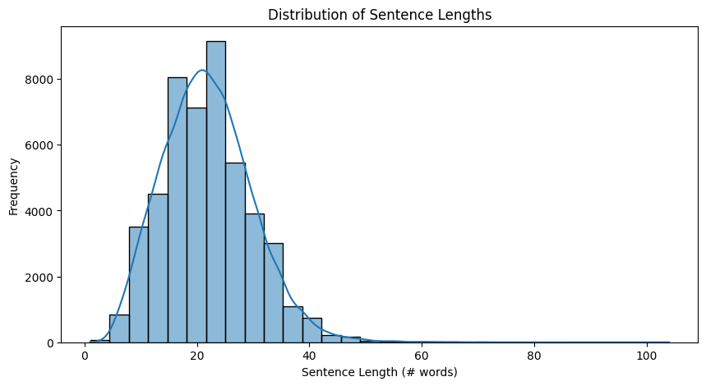
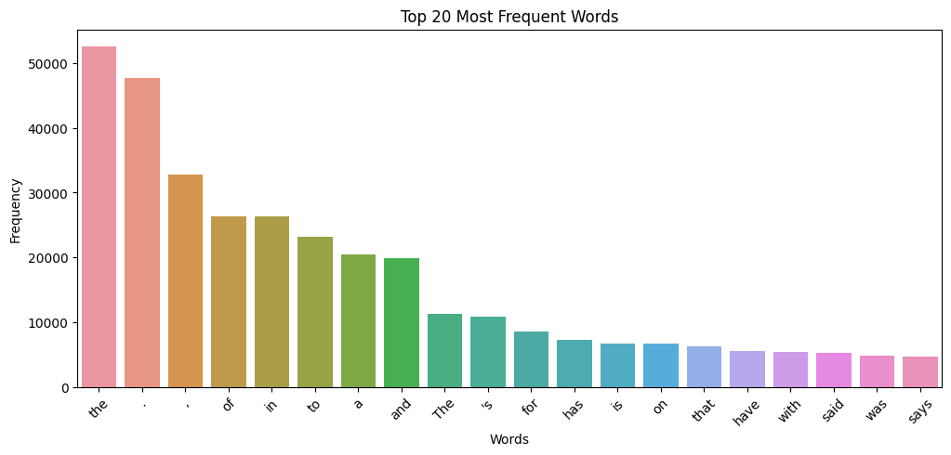
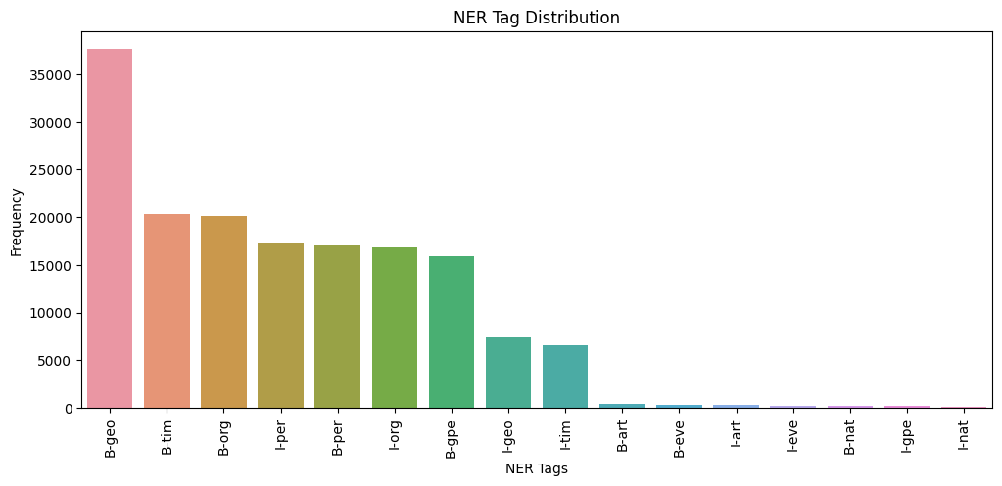
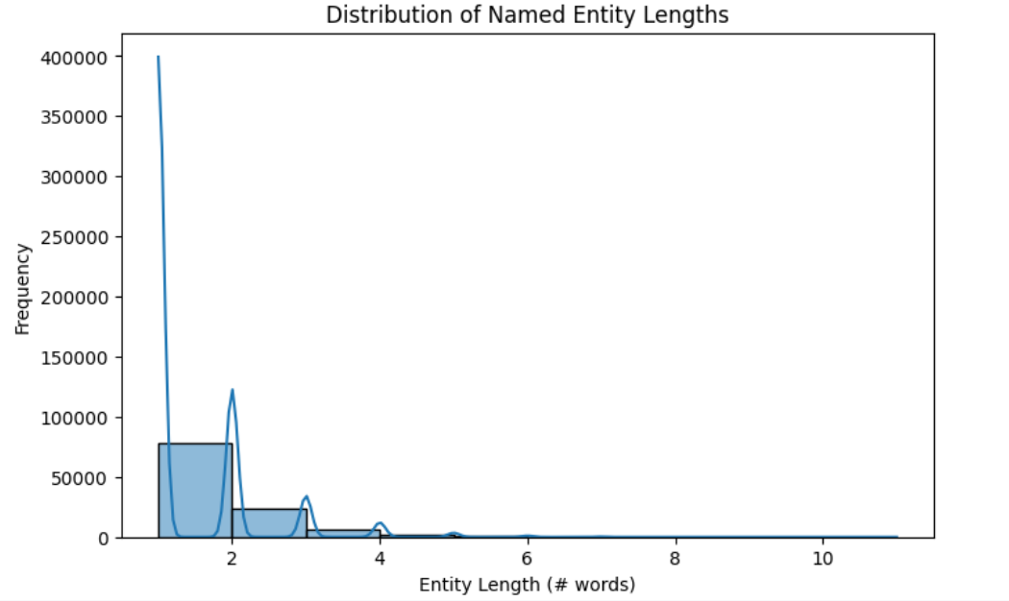
EDA
Unique no. of Sentence- 47959
Unique no. of Words- 35177
Unique Tags- 17
Total Named Entities: 111891 Average
Named Entity Length: 1.44 words

Slide 4
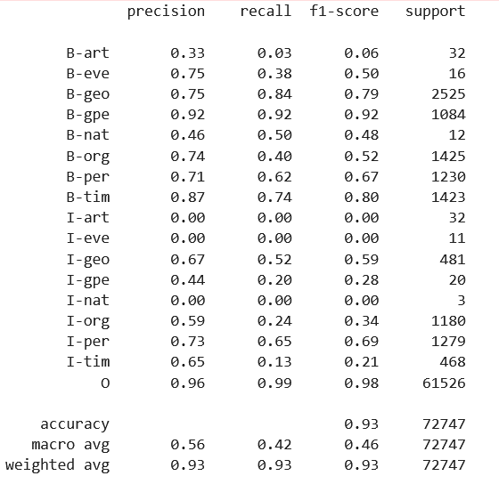
Base Line Model-Logistic Regression
Approach
Evaluation for Validation Data
Preprocess and Clean Data
Split into 80%(train+Val)-20%(test): Training samples: 23134 Validation samples: 3305 Test samples: 6610
Feature Engineering: lower,upper,title,isdigit
Vectorize and Encode labels
Fit Model on LR classifier for every tag.
Disadvantage:
Lack Contextual Meaning of words in sentences

Slide 5
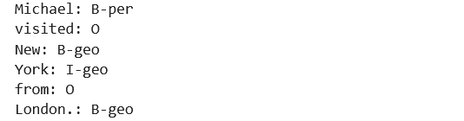
Advanced Model-BIDIRECTIONAL LSTM
Approach
Evaluation for Validation Data
Preprocess and Clean Data: Creating words and tags index, padding and encoding
Split into 80%(train+Val)-20%(test): Training samples: 38367 Test samples: 9592
Build Neural Network with BI(LSTM), Embeddings, TimeDistributed, Softmax, Early Stopping and Loss function components.
Prediction Function: Predicts name entities for new sentence
Model Accuracy-96.6 %
Input: "Michael visited New York from London."
Model Prediction

Slide 6
Model Deployment
A robust ML pipeline should automate model training, validation, and deployment.
CI/CD Pipeline for ML Model Deployment
1. Continuous Integration (CI)
Trigger: When code is pushed to repository.
Run Unit Tests: Ensure preprocessing, tokenization, and LSTM work as expected.
Data Validation: Check for schema changes.
2. Model Training Pipeline
Train models in a cloud environment (AWS SageMaker, Vertex AI, or Kubernetes).
3. Continuous Deployment (CD)
Use GitHub Actions / Jenkins / ArgoCD to deploy models automatically.
Store models in AWS S3 / Google Cloud Storage.
Deploy using Kubernetes & FastAPI/TensorFlow Serving.
4. Automated Retraining Workflow
Monitor model performance (accuracy drop triggers retraining).
Schedule retraining jobs using Apache Airflow.
Deploy updated models automatically if they pass validation.

Slide 7
THANK YOU

